Slide 1

CSE 412: Machine Learning Lab
Handwritten Character Recognition with Neural Network
Presented to
Afroza Akter
Lecturer
Dept. of CSE
Green University of Bangladesh
Presented by
Estiak Hasan Emon
Shamima Aktar Touhidul Islam

Slide 2
Contents
Introduction
Motivation
Literature Review
Objectives
Methodology
Tools and Technology
Application
Limitation and Future scope
Conclusion
Handwritten Character Recognition with Neural Network
2/13

Slide 3
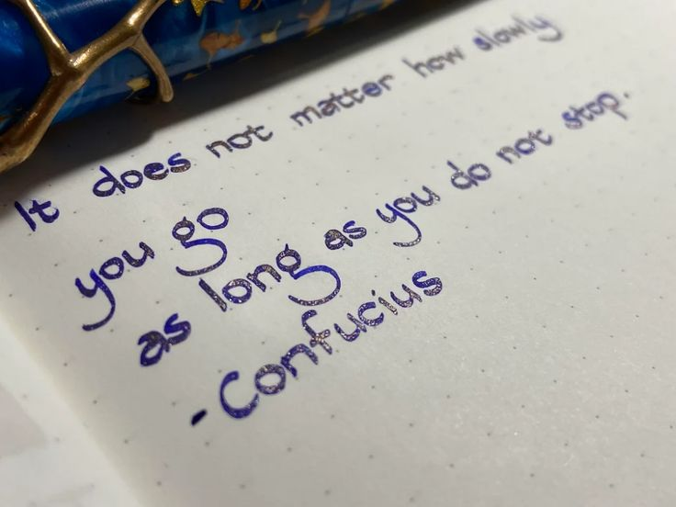
Introduction
OCR, involves computer software
designed to translate images of
typewritten text into
(ASCII or Unicode).
OCR began as a field of research
in artificial intelligence and machine
vision.
Though academic research in the
field continues, the focus on OCR has
shifted to implementation of proven
techniques.
Handwritten Character Recognition with Neural Network
3/13

Slide 4
Motivation
Neural Networks are recently being used in various kind of pattern recognition.
Handwritings of different person are different.
Handwritten Character recognition is an area of pattern recognition that has become the subject of research
High recognition accuracy and minimum training time of handwritten English characters using neural network is an open problem.
Handwritten Character Recognition with Neural Network
4/13

Slide 5
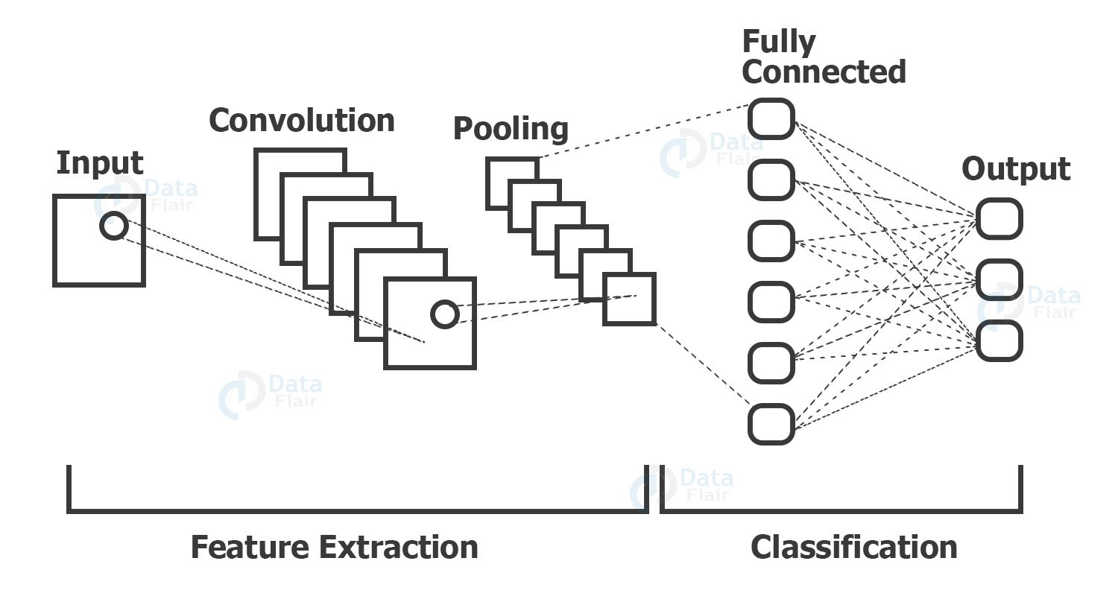
Literature Review
Handwritten Character Recognition with Neural Network
5/13

Slide 6
Objectives
To develop a system that can accurately recognize and classify handwritten characters .
To handle variations in handwriting styles and variations in writing quality .
To handle variations in handwriting styles, different writing utensils, and variations in writing quality .
To recognize and classify characters from various writing systems.
Handwritten Character Recognition with Neural Network
6/13

Slide 7
Methodology
Input
Dataset
Split data into image
Label data
Reshape Data
Shuffling
Data
Plotting the number of Alphabet
Fitting Model
Training & test Data
Train &
Validation
Predict test
Data
Predict on external
Image
Handwritten Character Recognition with Neural Network
7/13

Slide 8
Tools & Technology
Google Colab
Using pandas
Using numpy
Some Library
Dataset
Handwritten Character Recognition with Neural Network
8/13

Slide 9
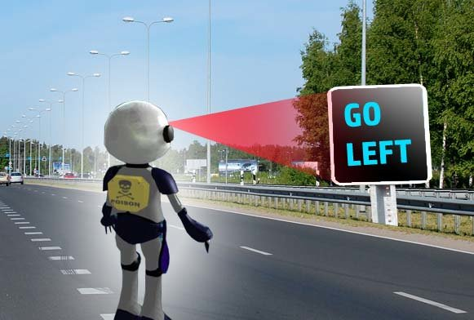
Application
Word Processing
Legal Documentation
Banking
Legal Documentation
Handwritten Character Recognition with Neural Network
9/13

Slide 10
Limitation and Future Scope
Limitation
Prediction only English alphabet
Predict just one letter in one time
Future Scope
Using different types of language
Prediction multiple letter in one time
Handwritten Character Recognition with Neural Network
10/13

Slide 11

Conclusion
A system for recognizing handwritten English
characters will be developed.
By achieving these objectives, a handwritten
character recognition system can find
applications in various domains, including
document digitization, form processing,
OCR, and NLP tasks involving handwritten
text
Handwritten Character Recognition with Neural Network

Slide 12


Slide 13
Thank You

